Slide 1
Cruise Control
Josh and Amos

Slide 2
Problem Overview
The challenge of maintaining a car's constant "set speed" during long highway trips by controlling acceleration and braking to counteract external forces
Manage speeds when going downhill, encountering headwinds, or dealing with tailwinds
The system must monitor the current velocity (u) relative to the desired speed (r) and apply the necessary force (u) to stay on target

Slide 3
Assumptions
The car moves in only one direction- positive x
Friction is linearly proportional to velocity
Friction of the ground does not typically increase with velocity
Air resistance increases with velocity squared
Mass is constant
The forcing control function is both immediate and directly applied
The velocity is always known
The road is perfectly flat

Slide 4

Base Model – Newton's 2nd Law
v(t) is the the quantity to be controlled and is in m/s
u(t) is the acceleration or braking force applied to the car
Parameter Values
m = 2000 kg
k = 40 kg/s
r_0 = 25 m/s
v(0) = 25 m/s

Slide 5
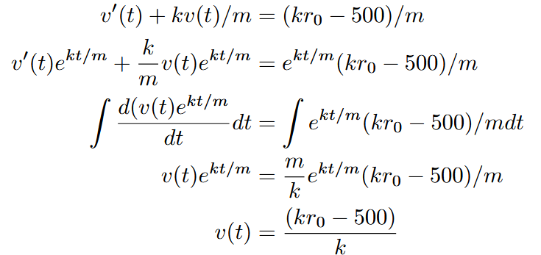
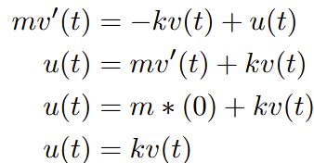
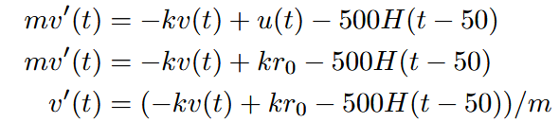

Analytical Solution to Open Loop

Slide 6
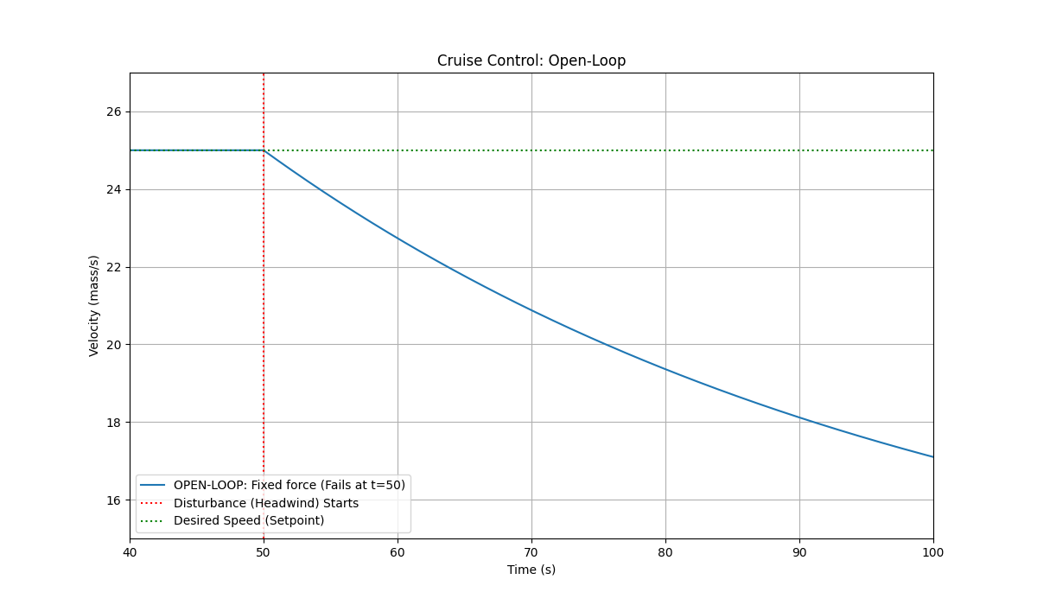
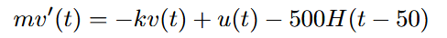
Open Loop
Notes:
Open-loop is like throwing a paper airplane: you give it a push and hope it hits the target, but you can’t change its path once it's in the air. Closed-loop is like driving a car: you constantly watch the road and adjust the steering wheel to stay in your lane, even if the wind tries to push you off course.
Open-loop control operates on a fixed preset without monitoring the system's actual performance, meaning it cannot correct itself if an external disturbance occurs. In contrast, closed-loop control uses a feedback loop to compare the actual output to a desired setpoint, allowing the system to automatically adjust its behavior to eliminate errors.

Slide 7
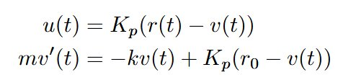


Analytical Solution to Closed Loop (Proportional Only)

Slide 8
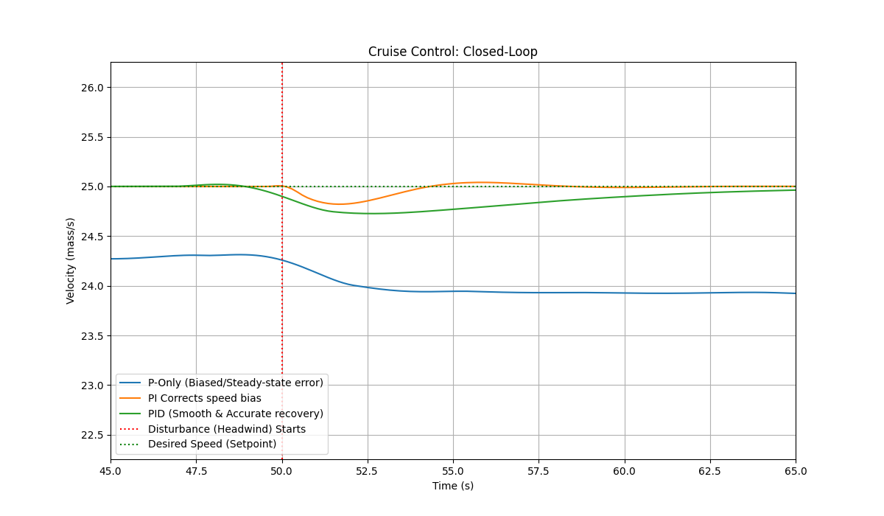


Closed Loop Proportional Control
Proportional Model (P)
Proportional-Integral Model (PI)
Proportional-Integral-Derivative Model (PID)
Notes:
P gets us close, I gets us exactly there, and D makes sure we don't spill our coffee getting there
Proportional (P) — The "Present"
"How far off am I right now?"
It applies a force proportional to the current error. If you’re 5 mph slow, it pushes a little; if you’re 20 mph slow, it pushes a lot.
Because it only pushes when there is an error, it can never actually reach the target speed—if it did, the engine would shut off. It always settles a bit short of the goal.
2. Integral (I) — The "Past"
"How long have I been off my target?"
It adds up the error over time. If the car has been slow for 30 seconds, the "I" term keeps building up pressure until the car is forced back to exactly 25 m/s.
It eliminates the "bias" or steady-state error. It ensures you actually hit your target.
It can cause Overshoot. Because it's "remembering" how slow you were, it might keep pushing even after you hit the speed limit, causing the car to go too fast.
3. Derivative (D) — The "Future"
"How fast am I approaching the target?"
It looks at the slope of the error. If it sees you are accelerating toward the target very quickly, it tapers off the force early to prevent you from overshooting.
It acts like a damper or a shock absorber. It smooths out the "ringing" and oscillations, making the ride much more comfortable.

Slide 9
Extensions
We could model quadratic air resistance instead of linear air resistance
We could have the wind be an oscillating function instead of constant
Investigate tailwinds vs only headwinds
Drive over different terrains instead of over a flat surface
Model Fuel Efficiency for different parameters

